Slide 1
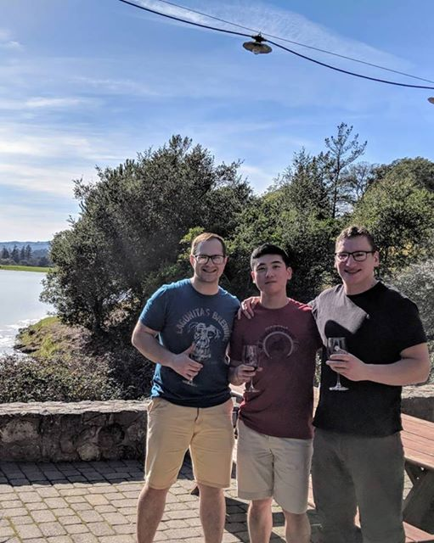
Supply Officer (S4)
CDT LT Sang Oh
Hometown: Seoul, South Korea
Major: Computer Science
Branch of Choice: Military Intelligence, Signal
Clubs: Kendo
Hobbies/Interests: Investing, sending emails, reading
business/self-improvement books

